Slide 1
ADO.NET - Lesson 02
The SqlConnection Object
Training time: 10 minutes
Author: CuongNV3

Slide 2
Objectives
Know what connection objects are used for.
Learn how to instantiate a SqlConnection object.
Understand how the SqlConnection object is used in applications.
Comprehend the importance of effective connection lifetime management.

Slide 3
Introduction
When interacting with a database, we need to create a connection.
The connection tells the rest of the ADO.NET code which database it is talking to. It manages all of the low level logic associated with the specific database protocols.
Create an instantiate the connection object, open the connection, and then close the connection when you are done.

Slide 4
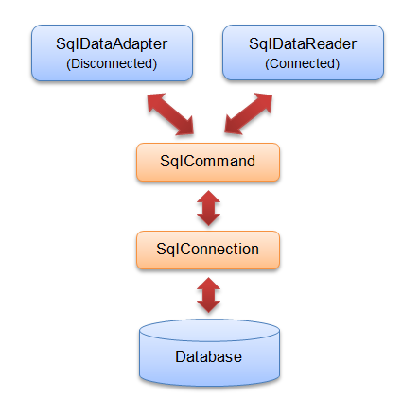
Introduction (2)

Slide 5







SQL Server Security
Send the username and password in clear text.
Web Server
Default ASP.NET settings
Mixed mode
authentication
Here is the username and password
SQL Server
Each user account added
to SQL Server logins group
or…
Do not send the username and password.
Just send that the user has been authenticated.
Client
Windows only
authentication
SQL Server
Only ASPNET account
is granted access
Web Server
Windows authentication

Slide 6
Creating a SqlConnection Object
ADO.NET Connection Strings contain certain key/value pairs for specifying how to make a database connection. They include the location, name of the database, and security credentials.
Connection String Parameter Name | Description
Data Source | Identifies the server. Could be local machine, machine domain name, or IP Address.
Initial Catalog | Database name.
Integrated Security | Set to SSPI to make connection with user's Windows login
User ID | Name of user configured in SQL Server.
Password | Password matching SQL Server User ID.

Slide 7
Creating a SqlConnection Object (2)
Window only authentication
Mixed mode authentication
Create an instantiate of the SqlConnection object
string connectionString = "Data Source=(local);Initial Catalog=Northwind;Integrated Security=SSPI";
string connectionString = "Data Source=(local);Initial Catalog=Northwind; User ID=sa; Password=123456789
SqlConnection connection = new SqlConnection(connectionString);

Slide 8
Using a SqlConnection
Instantiate the SqlConnection.
Open the connection.
Pass the connection to other ADO.NET objects.
Perform database operations with the other ADO.NET objects.
Close the connection.
Demo

Slide 9
Summary
SqlConnection objects let other ADO.NET code know what database to connect to and how to make the connection.
They are instantiated by passing a connection string with a set of key/value pairs that define the connection.
The steps you use to manage the lifetime of a connection are create, open, pass, use, and close.
Be sure to close your connection properly when you are done with it to ensure you don't have a connection resource leak.

Slide 10
Q&A
Thanks!

